Slide 1
Windows Azure SQL Database - Advance

Slide 2
Agenda
Database Sharding
Support for Sharding, a.k.a. Federation
Reporting Services
Data Sync

Slide 3
As Database Size Grows…
Performance drops…
Scale Up approach – Increase the size and processing power of the database
  Faster Processor
  More RAM
  Faster Disks
Scale Out approach – Increase the number of databases
  Use more low-cost machines
  Requires changes to software

Slide 4








1 x 10GB database
10 x 1GB databases

Slide 5
Why Scale Out?
Scale out on low cost commodity hardware, scale up requires much more expensive special hardware
Increased throughput for massive load
Higher Availability is an automatic side-benefit
Hardware failures impact only a part of the database
Increased relational database storage volume
Practically unlimited maximum database size, Scale Up reaches limits much earlier

Slide 6
Why not Scale Out?
Scale out requires:
  Redesigning the schema
  Rewriting the code
Solution:
  TCO for redesign and redevelop usually cheaper than that for scaling up
  For new projects, design for scaling out from the beginning
Increased complexity of database administration tasks
Increased network traffic
  Data Distribution
  Connection Routing

Slide 7
Scale Out - Sharding
Because it is achieved by breaking the database into pieces!
Shards of broken glass fly fast and have sharp edges
Shards of a database hope to fly faster than a single, monolithic database
And must have clear edges to avoid any confusion!

Slide 8
Sharding basics
Several databases are used to store a portion of the application’s data
The same schema is used across all databases
Data is horizontally partitioned among databases (shards) based on certain criteria (i.e.: geographical info, customer)

Slide 9
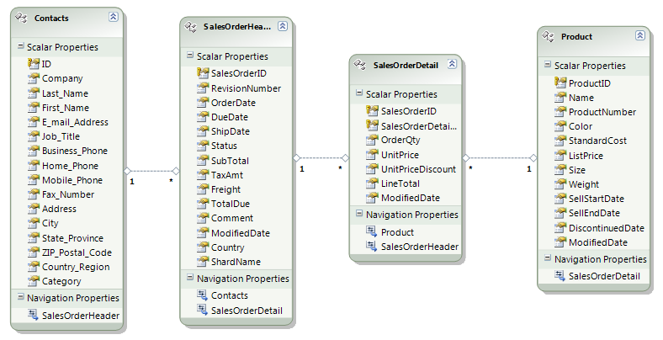
Sharding model
Primary Shard
Global
Shard Child
Global
Country, OrderDate ContactID could be the partition field

Slide 10
Scale Out Considerations
Database sharding causes complexity
Can you separate your database per tenant?
Partitioning strategy is highly dependant on scenario
  Look for a natural partitioning criteria that facilitates some of the common Use Cases
  Uniform partitioning via round-robin (modulo) can be highest performance

Slide 11
Scale Out Considerations
Apps may need to be changed / re-architected to take advantage
SQL Federation provides support
  you can do scale-out manually
  Effective scale/load testing is important to understand how to federate

Slide 12
SQL Federation features
Provides Scale-Out Support in SQL Database
  Partition data and load across many servers
  Bring computational resources of many to bear
Take advantage of elastic provisioning of databases
Pay as you go benefits
Zero physical administration
Federation includes
  Robust Connection Management
  Online repartition operations
  Split and Merge Databases

Slide 13
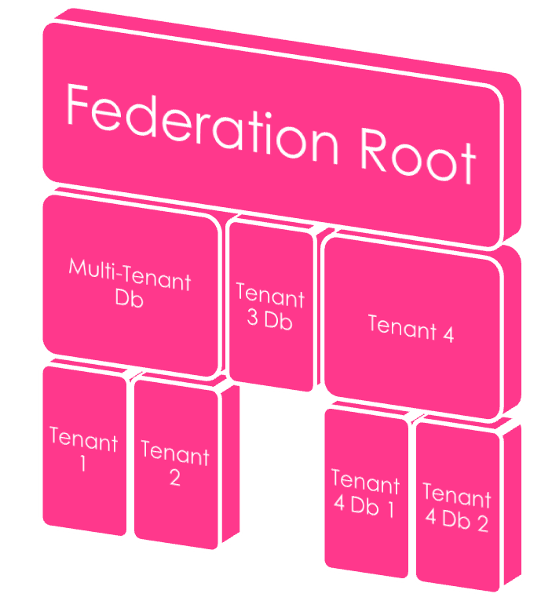
SQL Federation features (cont.)
Integrated database sharding that can scale to hundreds of nodes
Multi-tenancy via flexible repartitioning
Online split operations to minimize downtime
Automatic data discovery regardless of changes in how data is partitioned

Slide 14
SQL Federation features (cont.)
A logical database can contain multiple federations
Distribution scheme supports int, bigint, guid, and varbinary types
Filtering routes connection to appropriate shard regardless of changes in partitions
Merge, fan-out queries and automatic distribution of schema changes not supported in initial release

Slide 15


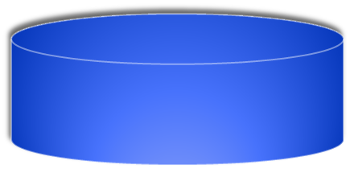
SQL Federation: Concepts
Federation
  Represents the data being partitioned
Federation (Distribution) Key
  The value that determines the routing of a piece of data to a particular Shard
Atomic Unit
  All rows with the same federation key value: always together!
Federation Member (aka Shard)
  A physical container for a range of atomic units
Federation Root
  The database that houses federation directory
Root
Federation “CustData”
(Federation Key: CustID)
Member: PK [min, 100)
AU
PK=5
AU
PK=25
AU
PK=35
Member: PK [100, 488)
AU
PK=105
AU
PK=235
AU
PK=365
Member: PK [488, max)
AU
PK=555
AU
PK=745
AU
PK=865

Slide 16
Federation Members
Federation member
    Federated data distributed by federation key range among members
    Attempt to insert or update federation key outside range generates error
    Member databases can have different sizes and different schemas
Federation key in:
    Clustered index
    Each unique index
A range distribution can be affected by:
    Data skew – data concentrated in one federation member
    Operational skew – data operations concentrated in one federation member

Slide 17
Table Types used
Federated tables are contained in federation members
  CREATE TABLE ( … )
  FEDERATED ON (CustomerId = custId)
Reference tables, also in federation members
  CREATE TABLE ( … )
Common tables are contained in the root database
Notes:
Individual members can contain distinct schema

Slide 18
Federation Operations
    T-SQL provides support for federations:
        CREATE FEDERATION
        USE FEDERATION
        ALTER FEDERATION
        DROP FEDERATION

Slide 19
SQL Reporting

Slide 20
Why?
Benefits:
  Elasticity
  Scalability
  Reliability
  of cloud computing
Cost effective:
  Decrease Capital expenditure
  Faster time-to-solution
Symmetrical: Design, develop and deploy BI solutions to the Cloud using the tools and expertise already in use with on-premises data sources

Slide 21
On-premises SQL Server Reporting Services
Delivers enterprise, Web-enabled reporting functionality
Queries a wide variety of data sources
Publishes reports in various formats
Manages security on content and tasks centrally
Supports pull- or push-driven report delivery
Scales to support thousands of users
Enables extensions to core functionality
Delivers ad hoc reporting capabilities
Available in all editions of SQL Server, except Compact
Notes:
This slide is for

Slide 22
The Reporting Life Cycle - Authoring
Data access to a variety of sources
  SQL Server, Analysis Services (cubes and data mining), Reporting Services Report Models, SharePoint Lists
  Oracle, Teradata, Hyperion Essbase, SAP NetWeaver BI
  OLE DB, ODBC, XML
Report Definition Language (RDL)
Report authoring options
  Report Designer (hosted in BIDS)
  Report Builder 3.0

Slide 23
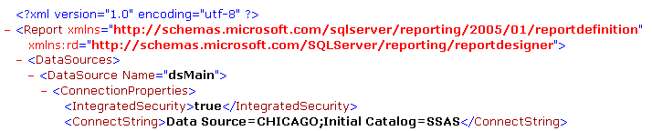
Report Definition Language (RDL)
RDL is an XML representation of report definition
Open and publicly documented schema used to:
  Programmatically generate reports
  Extend RDL with additional attributes and elements
Commonly graphic designers produce RDL
Notes:
A report is completely defined by an RDL document which is an XML grammar. It is a published standard that is supported by an XSD schema. Custom tags can be passed through to rendering extensions.

Slide 24
The Reporting Life Cycle – Management
Scalable Web service architecture
Managed report execution:
  On-demand
  Multi-user shared cache
  Scheduled
  Historical snapshots
Role-based security model
Object Explorer and Report Manager
Notes:
On-demand: System executes a report based on current data when requested by a user
Multi-user shared cache: The report data can be temporarily stored and shared across all users – ideal for increased performance and/or to reduce the load on the database server, where the data in reasonably non-volatile.
Scheduled: Execution can be scheduled and the results saved temporarily on the Report Server to prepare the data for end-user reporting.
Historical snapshots: The report data is permanently stored and made available as a history report. For example, monthly financial reports from an OLTP system that users may need to go back and refer to over time.
Role-based security allows administrators to use predefined roles for securing reports and resources. Administrators can define their own roles also.
Report Manager and the Object Explorer feature of SQL Server Management Studio provide a convenient management interface of the Report Server instance.

Slide 25
The Reporting Life Cycle - Delivery
Runtime report rendering:
  Hard page-break: PDF, TIFF (Image)
  Soft page-break: Excel, Word, HTML, MHTML
  Data renderers: CSV, XML, OData
Pull delivery: Report requested by user
  URL Access (Report Manager or Report Server)
  VisualStudio 2010 / 2012 ReportViewer Control via WinForms or WebForms apps
  SharePoint document library and Web parts
Push delivery: Report delivered by Report Server
  Standard subscriptions
  Data-driven subscriptions
  Delivery to email, folder or document library
Notes:
Emphasize that the rendering process is a runtime concept: for on-demand reports the user selects the report and the format. This slide introduces the different rendering formats. Ensure students are familiar which each type. During the presentation of the different data regions and report items be sure to mention the appropriateness of each rendering format.
Make specific note about the ATOM render format. It enables a report to be exported as data feeds.
Pull delivery refers to an external process or user requesting the report.
Push delivery refers to an internal process requesting the report. Discuss the two types of subscriptions here: Standard can be configured by users. The Data driven subscriptions are configured by administrators and allows the distribution of reports to multiple channels.

Slide 26
Reporting Services and SQL Database
SQL Server Reporting Services hosted on premise
Support for SQL Database as a data source
All SSRS tools and features work for reports against SQL Database
Notes:
A good approach for enterprises that are migrating to the Cloud is to run SSRS on-premises till all databases have been moved.
© 2007 Microsoft Corporation. All rights reserved. Microsoft, Windows, Windows Vista and other product names are or may be registered trademarks and/or trademarks in the U.S. and/or other countries.
The information herein is for informational purposes only and represents the current view of Microsoft Corporation as of the date of this presentation. Because Microsoft must respond to changing market conditions, it should not be interpreted to be a commitment on the part of Microsoft, and Microsoft cannot guarantee the accuracy of any information provided after the date of this presentation.
MICROSOFT MAKES NO WARRANTIES, EXPRESS, IMPLIED OR STATUTORY, AS TO THE INFORMATION IN THIS PRESENTATION.

Slide 27
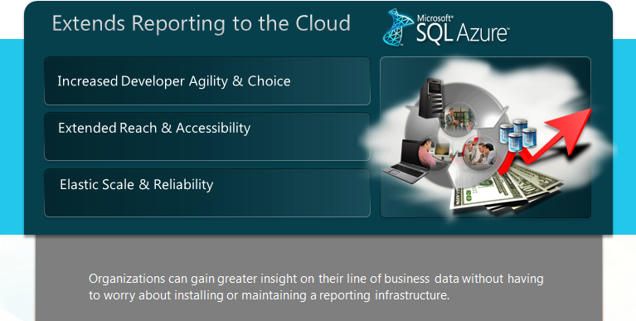
Extend Reporting to the Cloud

Slide 28
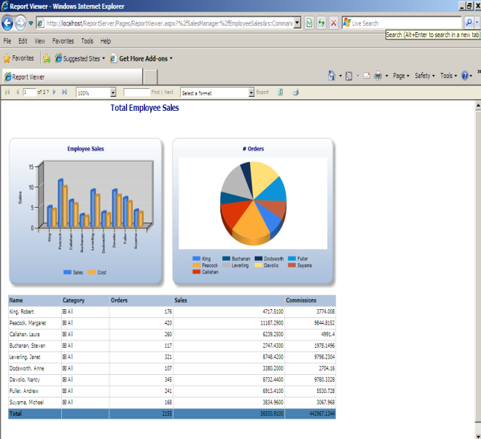
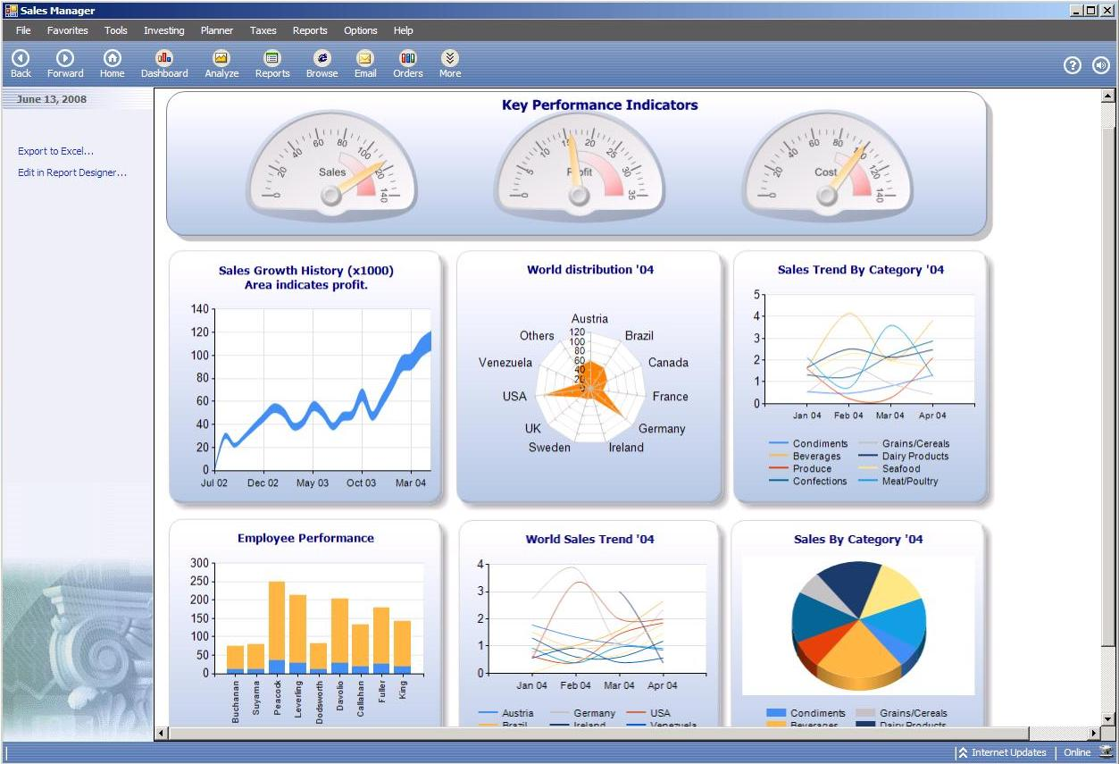
SQL Reporting Scenarios
“Operational reports over SQL Database data” – Customers can report over their SQL Database data, not necessarily with the intent to embed them into an application
“Embedding reports into Windows or Azure application” - Developers can use same patterns and tools they use today to embed reports into their applications in connected mode against SQL Databases

Slide 29
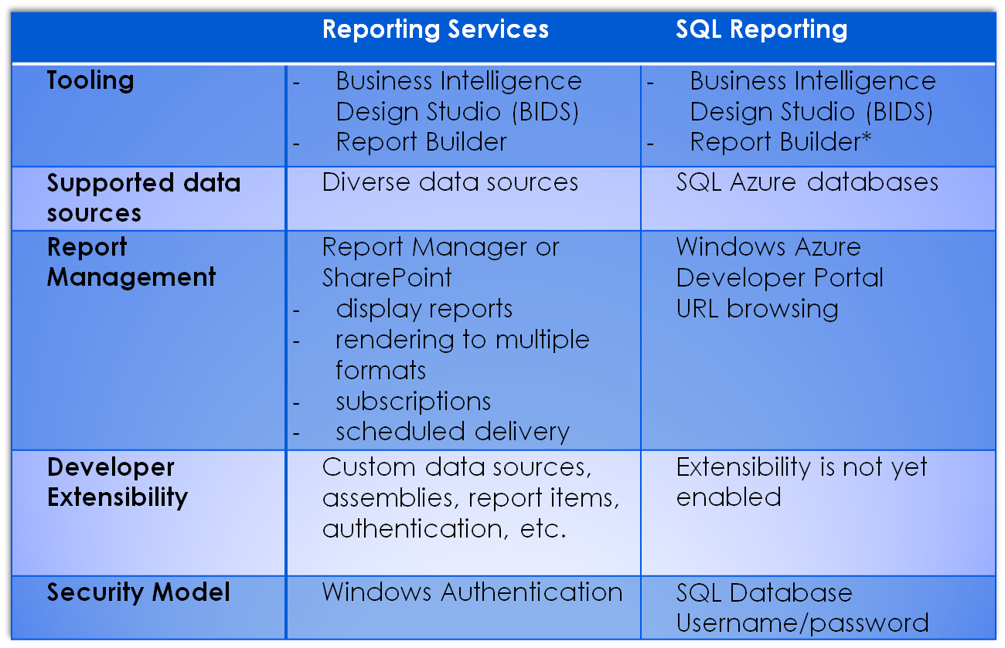
SQL Reporting Features
*Authoring only - deployment to SQL Reporting through BIDS

Slide 30







Architecture
Multi-tenant: RS Gateway for “smart” routing, separated tenant DBs
Availability: SQL Database is the data tier for Reporting Services
Elasticity: Built on Windows Azure
Supportability: Entire service captures monitoring and trace event data, runs on common management fabric
Security: SQL Server authentication and authorisation model
Load Balancer
Gateway nodes
RS nodes
database.windows.net
Catalog
TempDB
Data Source
…
https://[tenant].reports.windows.net/reports/report1.rdl

Slide 31


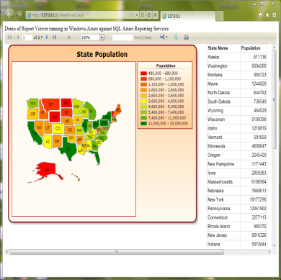

Security Model
Using the same roles and permission model as SSRS
Supports username/password (basic auth)
Windows Azure/Rich Client
Browser access
SQL Reporting

Slide 32
SQL Reporting in the Azure Developer Portal
Only the Azure Service Admin and Account Admin can access (similar to Windows and SQL Database)
Provision the service
  Select geo-location
Manage additional users
  Assigning them to default roles of SSRS
Browse and manage items
  Reports
  Data sources

Slide 33
SQL Data Sync

Slide 34
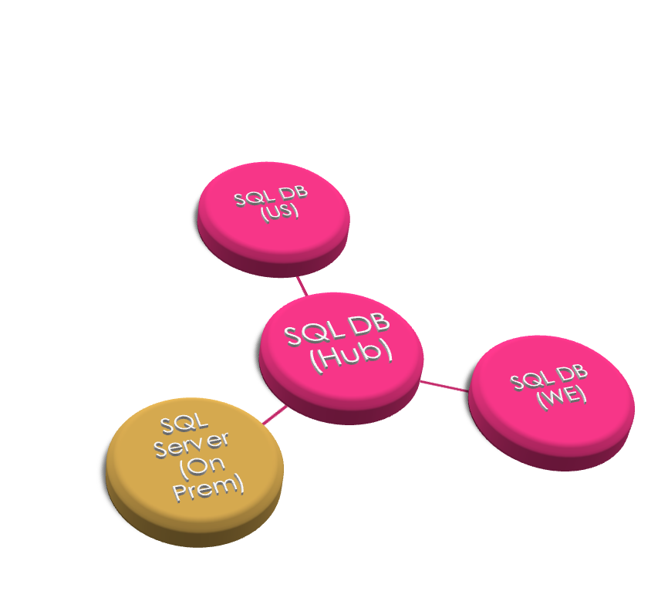
SQL Data Sync
Microsoft Sync Framework technology available as a service on the Windows Azure Platform
For synchronization between data sets hosted in SQL Database and / or SQL Server
Hub and spoke connection

Slide 35
SQL Data Sync
Conflict resolution policy configured centrally (hub or client wins)
Sync direction configured between each client and the hub (to hub, from hub, bi-directional)
Sync schedule time limits must be between 5 minutes and 1 month
Data sets include multiple tables and can be filtered, triggers are added to data set tables
Tables added to hub and client schemas
Agent must be installed for on-premises clients

Slide 36
Provisioning synchronization groups
Deploy database to hub and clients
Set synchronization schedule
Set conflict resolution policy
Define data set
Add SQL Azure clients to topology
Install agents on SQL Server clients and add them to topology using keys
Deploy topology

Slide 37
SQL Data Sync – Operational considerations
Manual synchronization supported
Hub updates require one synchronization to distribute to all clients
Client updates require two synchronizations to distribute to all clients
Sync Framework triggers may affect application behavior

Slide 38
To Summarise:
Windows Azure SQL Database is a true RDBMS in the Cloud
There are fundamental differences in the way you use the Cloud version

Slide 39
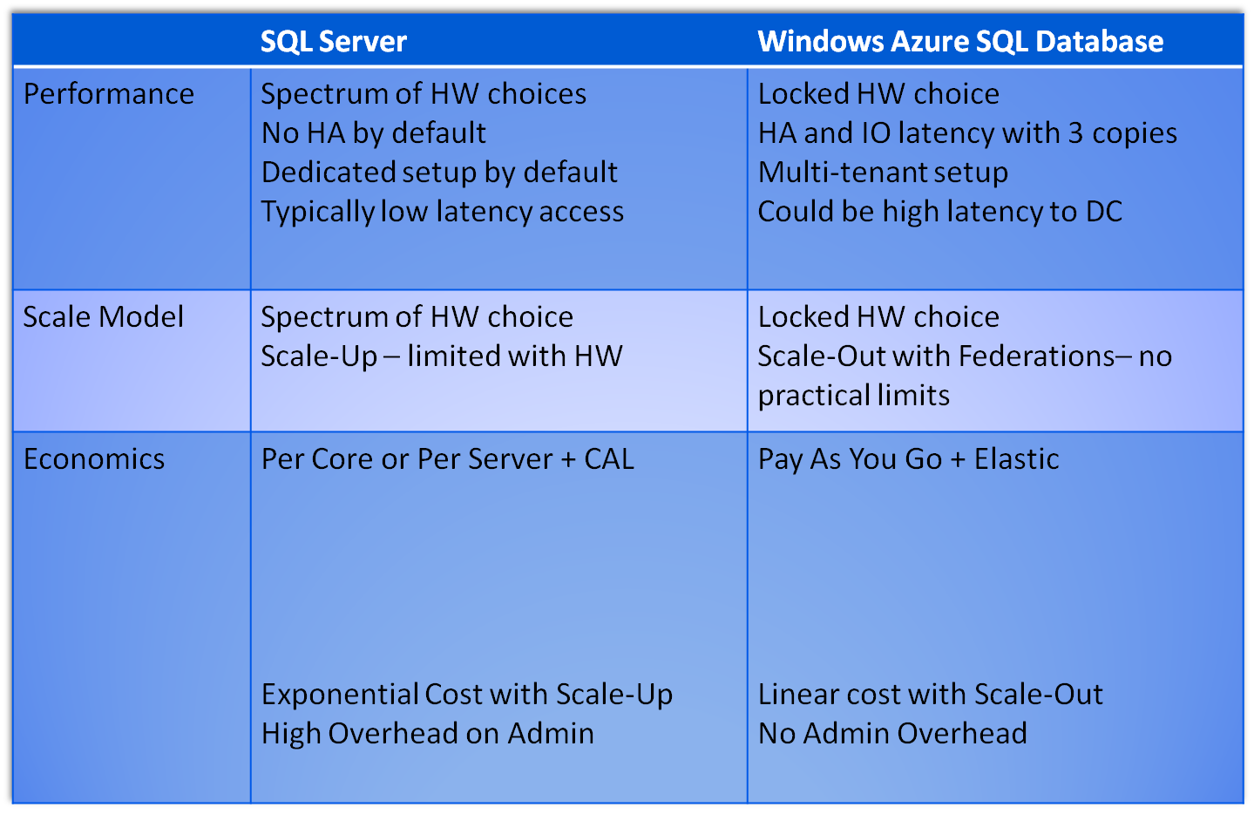
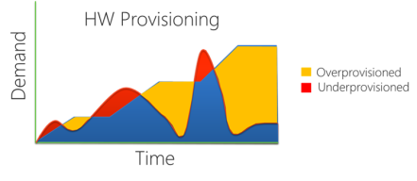
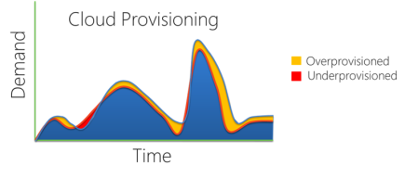
Top Architectural Differences
Notes:
Recap from previous lecture

Slide 40
Top Programming Differences
Scale-out for scale and performance
  Take advantage of rapid scale up / scale down
Leverage Parallelism for efficiency
  Use many small databases
  Get around both network and disk IO latency
Code for Failure
  Divide long transactions into many smaller transactions – so fail small
  Integrate retry and resume logic into all operations due to latency / throttling issues
Notes:
Recap from previous lecture

Slide 41
Quiz
Q: Which of the following are advantages of Scaling Out over Scaling Up?
  Higher throughput
  Lower bandwidth
  Lower Cost
  Higher Availability
Ans: 1, 3 and 4. The Bandwidth requirement remains unchanged.

Slide 42
Quiz
Q: The network topology supported by SQL Data sync is:
  Peer to Peer
  Hub and Spoke
  Star
  Ad-hoc
Ans: Hub and Spoke

Slide 43
Further Reading
More about SQL Reporting at: https://www.windowsazure.com/en-us/manage/services/other/sql-reporting/
Details of Federations at: http://msdn.microsoft.com/en-us/library/windowsazure/hh597452.aspx

